Slide 1
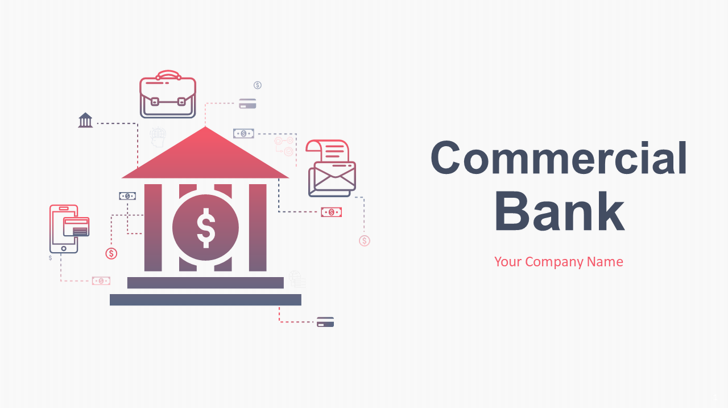

E-Banking Mechanism
Presented by-
(1).Sameer Bhatt (Leader) [40]
(2).Santosh Upadhyay [41]
(3).Narad saud [27]
(4).keshav Raj Bhatt [22]
Far-West University, School Of Engineering

Slide 2

Contents
INTRODUCTION
LITERATURE REVIEW
METHODOLOGY
EPILOGUE

Slide 3

Introduction
Background
Problem Statement
Objectives
Applications
Project Features
Feasibility Analysis
System Requirement

Slide 4

Background
Provided as a tool to the bank,
Completely computerized, so it is not a time-consuming process,
Record for daily banking transactions,
Facilitate the addition of new customer account, deletion of account and modification of existing customer account,
Provide user friendly interface for retrieving customer related details just in a few seconds, with 100% accuracy.

Slide 5
Problem Statement
Opening an account can take longer,
Need to complete a paper application,
Have to wait until you can get into a branch for service,
Higher fee charges.

Slide 6
Objectives
Create a banking system that is easily via internet
Reduce the flow of human traffic causing long queues at banks resulting in consumption of valuable time.
Develop a bank customer management system with a multi-level security measure that will restore the customers’ confidence.

Slide 7
Application
Mainly, this project is applicable for the financial institutions which includes Banks, Laghubitta, at training programs for the new employer of Banks and the student of such fields.

Slide 8
Features
Easy to sign up or apply for new accounts,
Offer extensive to manage almost every aspect of your account from almost anywhere,
Low fees or no fees for services like checking and savings accounts and some loan products,
Centralized database (located, stored, and maintained in a single location).

Slide 9
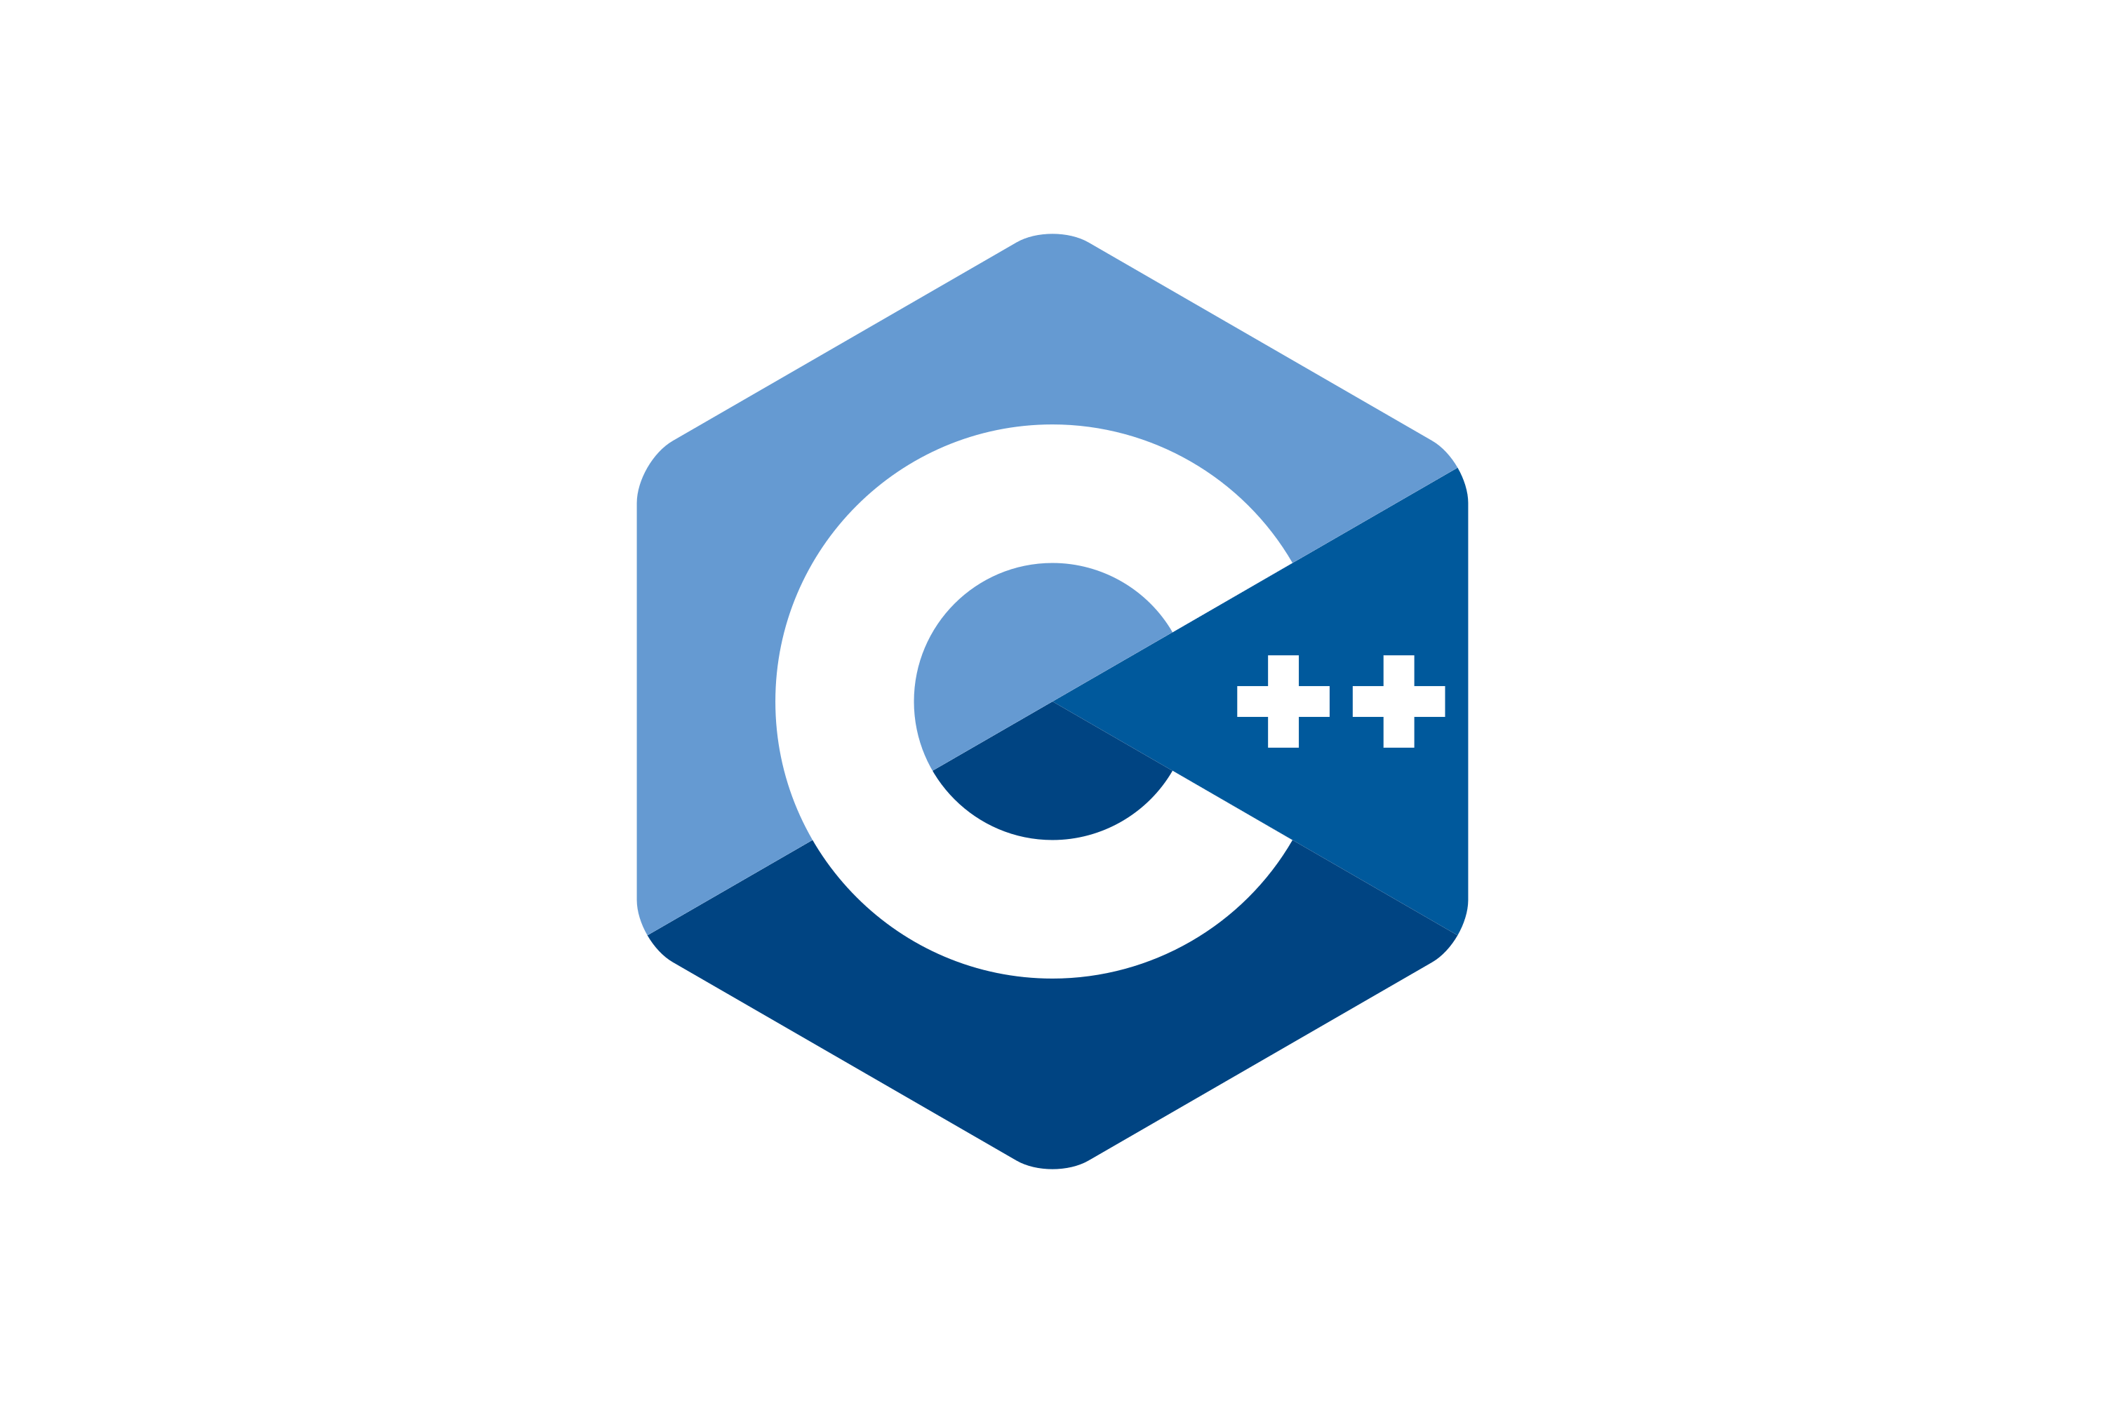
Feasibility Analysis
Economic Feasibility
Since this software is specially made for the banking institutions’, the investment in this software will be of the bank .The bank may apply certain charges on using this application to the customer which will indeed generate some revenue.
Technical Feasibility
In this project, we have used Object Oriented Programming language C++which is written in VS Code .The technicians or manpower needed for this project are qualified in C++ language.

Slide 10
System Requirement
1.7.1-Hardware Requirement
For running this software, the minimum requirement is to have a laptop or mobile devices with a proper net connection.
1.7.2-Software Requirement
The minimum software requirement is to have an IDE’s( integrated development environment) like VS Code, Code Blocks etc Installed in the laptop or mobile devices.

Slide 11
Literature review
In past days, similar project has been already developed with similar features and platform. For example, various reputed banks in Nepal is concurrently using similar type of system allowing the people to enjoy bank facility.
Banking System is an online system which is developed in order to organize the person’s account in a bank.
The system provides the access to the customer to create an account, deposit/withdraw the cash also view the records of accounts

Slide 12
This type of tasks have done already and all are accurate and reliable, but need some modification.
But the main objectives of this project is to implement it on small scale banking branches which is not providing this kind of facility.
So, by allowing this facility the people would save lots of efforts when needing to perform financial transactions and hope our project to be useful at least in some manner.

Slide 13
CHAPTER 3: METHODOLOGY 3.1 System Analysis The proposed project from our group is a bank management system. Our software will enable the users to perform various banking task like create account, withdraw/deposit money transfer of money from one account to another, loan, mobile banking, online banking, money exchange. They can access their account through ATM. Bank will able to keep the record of their employee.

Slide 14
3.2 Algorithm
3.2.1For Creating Account
Step 1: Start
Step 2: Create a new account Form
Step 3: Is form verifiable? If YES go to Step 4If NO go to Step 6.
Step 4: Create the account and register it on database.
Step 5: Show the message “Account Created”
Step 6: Stop

Slide 15
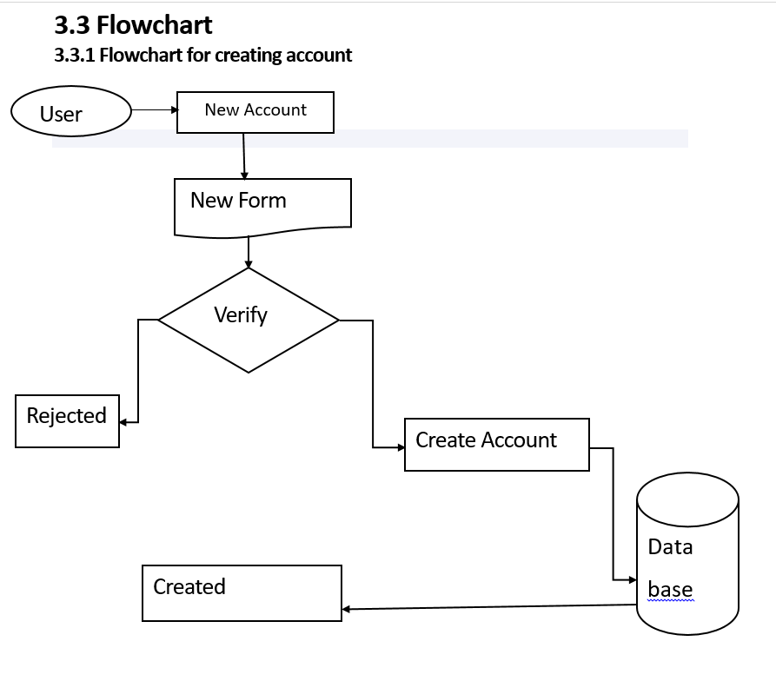

Slide 16
3.2.2To Withdraw/Deposit Account
Step 1: Start
Step 2: Select 1 for Withdraw and 2 for Deposit
Step 3: If 1 is selected, then withdraw the amount after verification and go to step 5.
Step 4: If 2 is selected, then deposit it after verification and go to step 5.
Step 5: Stop

Slide 17
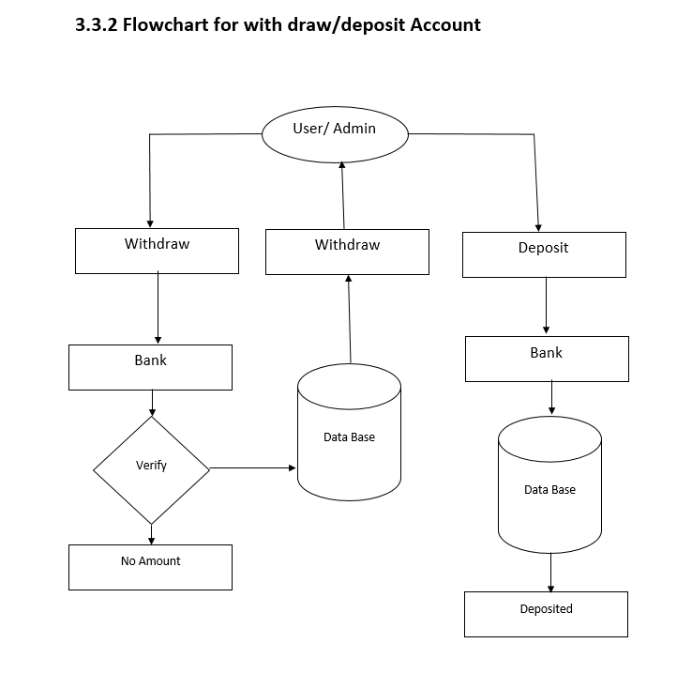

Slide 18
3.2.3For deleting an Account
Step 1: Start
Step 2: Admin Login
Step 3: Select the Delete option
Step 4: Provide necessary details for deletion
Step 5: Remove the details from the database.
Step 6: Show the message “Account deleted”
Step 7: Stop

Slide 19
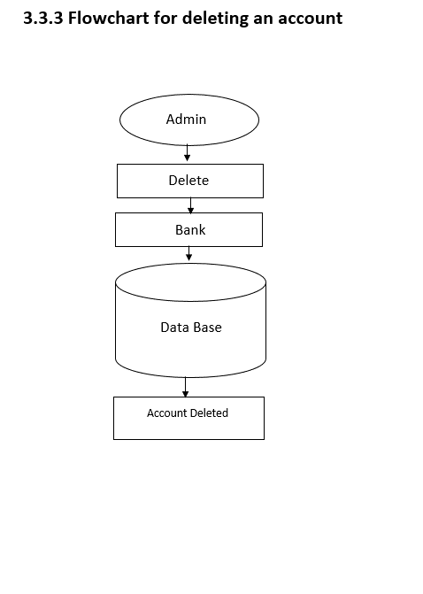

Slide 20
Coding and Implementation:
At this stage, we will start coding as per the design specifications. The output of this step is one or more product components built according to a pre-defined coding standard and a debugger, tested and integrated to satisfy the system architecture requirement.
Coding:
Coding is the construction of an actual system using specific language. For this bank management system project, I have used Object Oriented Programming language that is C++.

Slide 21
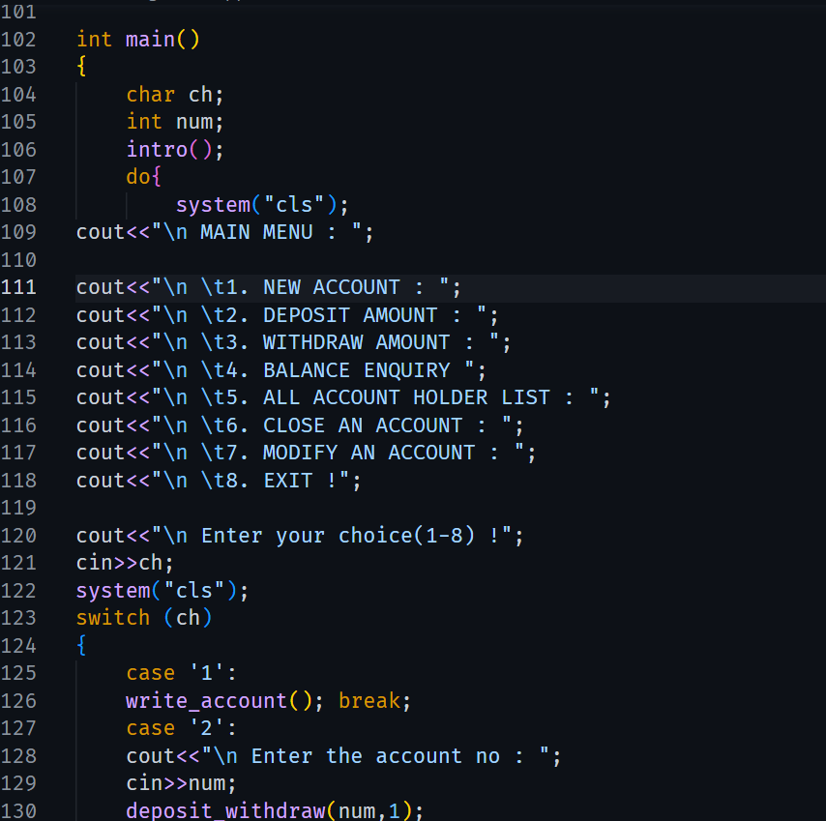

Slide 22
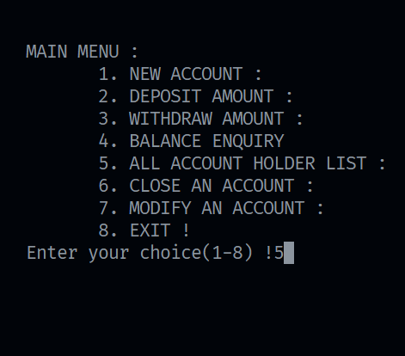
Testing: It is the process of verifying and validating the system for the performance with specifications and meeting the customer requirements.

Slide 23
CHAPTER 4: EPILOGUE
4.1 Expected outcomes:
Here are some of the features available through banking system.
View balance: Firstly login your account with your account number. Then check your balance and simply select account balance and withdraw balance and look at your past transaction.
Transfer fund: When you select transfer fund, you will be asked where to transfer money.
Pay Bills: To pay your bills online , you just need to add to your account the names of companies you wish to pay bills.
Create or delete account: we can easily create or delete account when needed

Slide 24
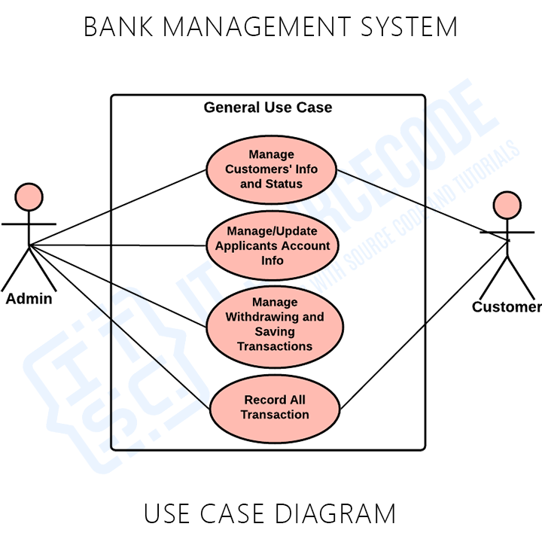
Bank management system use case diagram:
This diagram discusses the meaning of the Bank Management System project UML as well as its use case diagram using include and extend.

Slide 25
4.2 Budget analysis
We have divided budget according to necessities and requirement of our project. The estimated Cost structure of the project is shown below:
SN particulars Amount
1 Proposal Printing 250
2 Final Report with Hard Binding 1500
Miscellaneous 500
total 2500

Slide 26
4.3 work schedule:
After the announcement of our subject teacher we decided to make a minor project on the topic’ bank management system’. He taught us the effective way for writing the proposal and then we scheduled the time which is flexible to us so for this we decided to divide the proposal according to chapter wise. Which helps us to manage the time and give best for this. Firstly, we collected the details needed to us which took 1 week for this and than after further coding and following final report is made.
Week 1 | Week 2 | Week 3 | Week 4 | Week 5
Proposal preparation
coding
Testing and debugging
Documentation and report preparation

Slide 27
References
All the references are taken from net.

Slide 28

End Of Slide
#include<iostream>
using namespace std;
int main()
{
String attention;
Cin>>attention;
Cout<<“THANK YOU FOR”<<endl<<“YOUR ATTENTION!”;
Return 0;
}

